Slide 1

ADVANCE SOFTWARE TECHNOLOGIES
LINQ PART 1

Slide 2
Topics to be Covered
What is LINQ?
LINQ Architecture?
Simple LINQ Queries?
      Where Clause
      Select
      Partitioning Operator
      Order by
      Generation
      Arrays
      Set
      Count
      Sum
      Min
      Concat

Slide 3
LINQ
LINQ Stands for Language Integrated Query.
    It’s a new method of writing a Query within language.
    System.Linq--------Namespace used.
    IEnumerable interfaces used. They have some methods that help in data querying.
    LINQ main function Load data and query it within language code informally.

Slide 4
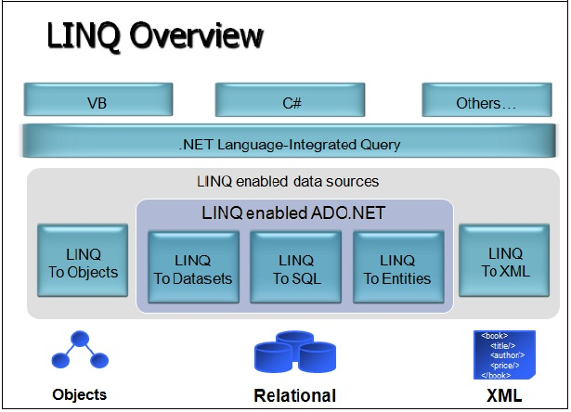
LINQ Architecture

Slide 5
LINQ Query
By using LINQ you can query and transform the data in
      XML Document
      SQL Databases
      ADO.NET Datasets
      .NET Collections

Slide 6
LINQ Query Operates
LINQ Query operation contains three parts
    1. Obtain the data source.
    2. Create the Query.
    3. Execute the Query
    Lets have example of it

Slide 7
LINQ Query Parts
/ The Three Parts of a LINQ Query:
// 1. Data source.
int[] numbers = { 5, 4, 1, 3, 9, 8, 6, 7, 2, 0 };
// 2. Query creation.
// nameQuery is an IEnumerable<string>
var lowNums = from n in numbers where n < 5 select n; Console.WriteLine("Numbers < 5:");
// 3. Query execution.
foreach (var x in lowNums) { Console.WriteLine(x); }
Console.ReadKey();
Query expression contains three clauses from, where and select.
The from clause specifies the data source, where clause applies the filter andselect clause specifies the types of returned elements.

Slide 8
Where/ Restricted Clause
int[] numbers = { 5, 4, 1, 3, 9, 8, 6, 7, 2, 0 }; var lowNums = from n in numbers where n < 5 select n; Console.WriteLine("Numbers < 5:"); foreach (var x in lowNums) { Console.WriteLine(x); }

Slide 9
Simple Select Clause
int[] numbers = { 5, 4, 1, 3, 9, 8, 6, 7, 2, 0 }; var numsPlusOne = from n in numbers select n + 1; Console.WriteLine("Numbers + 1:"); foreach (var i in numsPlusOne) { Console.WriteLine(i); }
Note: this will add 1 in the given above array

Slide 10
Portioning Operator
int[] numbers = { 5, 4, 1, 3,90,98,98,976,99, 9, 8, 6, 7, 2, 0,100 };
var first3Numbers = numbers.Take(8);
Console.WriteLine("First 8 numbers:");
foreach (var n in first3Numbers)
{
Console.WriteLine(n);
}
Note: take() IEnumerable type and send contiguous number of elements from start

Slide 11
Orderby Operator
string[] words = { "cherry", "apple", "blueberry" }; var sortedWords = from w in words orderby w select w; Console.WriteLine("The sorted list of words:"); foreach (var w in sortedWords) { Console.WriteLine(w); }
Note: here orderby alphabetically

Slide 12
Generation Operator
var numbers = from n in Enumerable.Range(100, 50) select new { Number = n, OddEven = n % 2 == 1 ? "odd" : "even" }; foreach (var n in numbers) { Console.WriteLine("The number {0} is {1}.", n.Number, n.OddEven); }
Note: ? Is ternary operator and in this case if condition is true, First will be result else second.

Slide 13
Arrays Sorting
double[] doubles = { 1.7, 2.3, 1.9, 4.1, 2.9 }; var sortedDoubles = from d in doubles orderby d descending select d; var doublesArray = sortedDoubles.ToArray(); Console.WriteLine("Every other double from highest to lowest:"); for (int d = 0; d < doublesArray.Length; d += 2) { Console.WriteLine(doublesArray[d]); }
Note: ? Toarray function is used. Sorts highest to lowest with decrement of 2

Slide 14
Set Operator
int[] factorsOf300 = { 2, 2, 3, 5, 5 }; var uniqueFactors = factorsOf300.Distinct(); Console.WriteLine("Prime factors of 300:"); foreach (var f in uniqueFactors) { Console.WriteLine(f); }
Note: ? Distinct() method is used for sorting distinct values

Slide 15
Grouping Operator
int[] numbers = { 5, 4, 1, 3, 9, 8, 6, 7, 2, 0 }; var numberGroups = from n in numbers group n by n % 5 into g select new { Remainder = g.Key, Numbers = g }; foreach (var g in numberGroups) { Console.WriteLine("Numbers with a remainder of {0} when divided by 5:", g.Remainder); foreach (var n in g.Numbers) { Console.WriteLine(n); } }

Slide 16
Count Operator
int[] factorsOf300 = { 2, 2, 3, 5, 5 }; int uniqueFactors = factorsOf300.Distinct().Count(); Console.WriteLine("There are {0} unique factors of 300.", uniqueFactors);
Program 2
int[] numbers = { 5, 4, 1, 3, 9, 8, 6, 7, 2, 0 }; int oddNumbers = numbers.Count(n => n % 2 == 1); Console.WriteLine("There are {0} odd numbers in the list.", oddNumbers);

Slide 17
Sum Operator
int[] numbers = { 5, 4, 1, 3, 9, 8, 6, 7, 2, 0 }; double numSum = numbers.Sum(); Console.WriteLine("The sum of the numbers is {0}.", numSum);

Slide 18
Min Operator
int[] numbers = { 5, 4, 1, 3, 9, 8, 6, 7, 2, 0 }; double numSum = numbers.Sum(); Console.WriteLine("The sum of the numbers is {0}.", numSum);

Slide 19
Concat Function
int[] numbersA = { 0, 2, 4, 5, 6, 8, 9 }; int[] numbersB = { 1, 3, 5, 7, 8 }; var allNumbers = numbersA.Concat(numbersB); Console.WriteLine("All numbers from both arrays:"); foreach (var n in allNumbers) { Console.WriteLine(n); }
Note: Concat() function used in which first variable is Sorce which is to Concatenated with Destination second variable

Slide 20
Sequence Matching
var wordsA = new string[] { "cherry", "apple", "blueberry" }; var wordsB = new string[] { "cherry", "apple", "blueberry" }; bool match = wordsA.SequenceEqual(wordsB); Console.WriteLine("The sequences match: {0}", match);
Note: Matches sequences of array and outputs true for yes and false for no

Slide 21



